Slide 1

INVESTOR PRESENTATION
August 2025

Slide 2
DISCLAIMERS AND CAUTIONARY STATEMENTS
Forward-Looking Information (1/4)
Unless otherwise noted or the context indicates otherwise, references in this presentation (this “Presentation”) to the “Company,” “Canopy Growth,” “we,” “us” and “our” refer to Canopy Growth Corporation and its direct and indirect wholly-owned subsidiaries and investments accounted for by the equity method.
This Presentation [(including any information which has been or may be supplied in writing or orally in connection herewith or in connection with any further inquiries)] contains “forward-looking statements” within the meaning of applicable securities laws, which involve certain known and unknown risks and uncertainties. To the extent any forward-looking statements in this Presentation constitute “financial outlooks” within the meaning of applicable Canadian securities laws, the reader is cautioned that this information may not be appropriate for any other purpose and the reader should not place undue reliance on such financial outlooks. Forward-looking statements predict or describe our future operations, business plans, business and investment strategies and the performance of our investments. These forward-looking statements are generally identified by their use of such terms and phrases as “intend,” “goal,” “strategy,” “estimate,” “expect,” “project,” “projections,” “forecasts,” “plans,” “seeks,” “anticipates,” “potential,” “proposed,” “will,” “should,” “could,” “would,” “may,” “likely,” “designed to,” “foreseeable future,” “believe,” “scheduled” and other similar expressions. Our actual results or outcomes may differ materially from those anticipated. You are cautioned not to place undue reliance on these forward-looking statements, which speak only as of the date the statement was made.
Forward-looking statements include, but are not limited to, statements with respect to: laws and regulations and any amendments thereto applicable to our business and the impact thereof, including uncertainty regarding the application of U.S. state and federal law to cannabis and hemp (including cannabidiol (“CBD”) products and the scope of any regulations by the U.S. Food and Drug Administration, the U.S. Drug Enforcement Administration, the U.S. Federal Trade Commission, the U.S. Patent and Trademark Office, the U.S. Department of Agriculture and any state equivalent regulatory agencies over cannabis and hemp (including CBD) products; expectations regarding the amount or frequency of impairment losses, including as a result of the write-down of intangible assets, including goodwill; our ability to refinance debt as and when required on terms favorable to us and comply with covenants contained in our debt facilities and debt instruments; the impacts of the Company’s strategy to accelerate entry into the U.S. cannabis market through the creation of Canopy USA, LLC (“Canopy USA”); expectations for Canopy USA to capitalize on the opportunity for growth in the United States cannabis sector and the anticipated benefits of such strategy; the timing and occurrence of the final tranche closing in connection with the acquisition of Lemurian, Inc. (“Jetty”) pursuant to the exercise of the option to acquire Jetty; the issuance of additional common shares of the Company (each whole share, a “Canopy Share” or a “Share”) to satisfy any deferred and/or option exercise payments to the shareholders of Mountain High Products, LLC, Wana Wellness, LLC and The Cima Group, LLC (collectively, “Wana”), Jetty and the issuance of additional non-voting and non-participating shares (“Non-Voting Shares”) in the capital of Canopy USA issuable to Canopy Growth from Canopy USA in consideration thereof; the acquisition of additional Class A shares of Canopy USA in connection with the investment in Canopy USA by the Huneeus 2017 Irrevocable Trust (the “Trust”) in the aggregate amount of up to US$20 million, including any warrants of Canopy USA issued to the Trust in accordance with the share purchase agreement entered into by the Trust and Canopy USA; the timing and occurrence of certain prepayments of the Company’s credit facility in connection with the agreement dated July 29, 2025 between the Company and certain lenders under such credit facility; expectations regarding the potential success of, and the costs and benefits associated with, our acquisitions, equity investments and dispositions; the grant, renewal and impact of any license or supplemental license to conduct activities with cannabis or any amendments thereof; our international activities, including required regulatory approvals and licensing, anticipated costs and timing, and expected impact; our ability to successfully create and launch brands and further create, launch and scale products in jurisdictions where such products are legal and that we currently operate in; the benefits, viability, safety, efficacy, dosing and social acceptance of cannabis, including CBD and other cannabinoids; our ability to continue as a going concern; our ability to maintain effective internal control over financial reporting; expectations regarding the use of proceeds of equity financings; the legalization of the use of cannabis for medical or adult-use in jurisdictions outside of Canada, the related timing and impact thereof and our intentions to participate in such markets, if and when such use is legalized; our ability to execute on our strategy and the anticipated benefits of such strategy;

Slide 3
DISCLAIMERS AND CAUTIONARY STATEMENTS
Forward-Looking Information (2/4)
the ongoing impact of the legalization of additional cannabis product types and forms for adult-use in Canada, including federal, provincial, territorial and municipal regulations pertaining thereto, the related timing and impact thereof and our intentions to participate in such markets; the ongoing impact of developing provincial, state, territorial and municipal regulations pertaining to the sale and distribution of cannabis, the related timing and impact thereof, as well as the restrictions on federally regulated cannabis producers participating in certain retail markets and our intentions to participate in such markets to the extent permissible; the timing and nature of legislative changes in the U.S. regarding the regulation of cannabis including tetrahydrocannabinol (“THC”); the future performance of our business and operations; our competitive advantages and business strategies; the competitive conditions of the industry; the expected growth in the number of customers using our products; expectations regarding revenues, expenses and anticipated cash needs; expectations regarding cash flow, liquidity and sources of funding; expectations regarding capital expenditures; the expansion of our production and manufacturing, the costs and timing associated therewith and the receipt of applicable production and sale licenses; expectations with respect to our growing, production and supply chain capacities; expectations regarding the resolution of litigation and other legal and regulatory proceedings, reviews and investigations; expectations with respect to future production costs; expectations with respect to future sales and distribution channels and networks; the expected methods to be used to distribute and sell our products; our future product offerings; the anticipated future gross margins of our operations; accounting standards and estimates; expectations regarding our distribution network; expectations regarding the costs and benefits associated with our contracts and agreements with third parties, including under our third-party supply and manufacturing agreements; our ability to comply with the listing requirements of the Nasdaq Stock Market LLC and the Toronto Stock Exchange; and expectations on price changes for products in cannabis markets.
Certain of the forward-looking statements contained herein concerning the industries in which we conduct our business are based on estimates prepared by us using data from publicly available governmental sources, market research, industry analysis and on assumptions based on data and knowledge of these industries, which we believe to be reasonable. However, although generally indicative of relative market positions, market shares and performance characteristics, such data is inherently imprecise. The industries in which we conduct our business involve risks and uncertainties that are subject to change based on various factors, which are described further below.
The forward-looking statements contained herein are based upon certain material assumptions , including: (i) management’s perceptions of historical trends, current conditions and expected future developments; (ii) our ability to generate cash flow from operations; (iii) general economic, financial market, regulatory and political conditions in which we operate; (iv) the production and manufacturing capabilities and output from our facilities, strategic alliances and equity investments; (v) consumer interest in our products; (vi) competition; (vii) anticipated and unanticipated costs; (viii) government regulation of our activities and products including but not limited to the areas of taxation and environmental protection; (ix) the timely receipt of any required regulatory authorizations, approvals, consents, permits and/or licenses; (x) our ability to obtain qualified staff, equipment and services in a timely and cost-efficient manner; (xi) our ability to conduct operations in a safe, efficient and effective manner; (xii) our ability to realize anticipated benefits, synergies or generate revenue, profits or value from our recent acquisitions into our existing operations; and (xiii) other considerations that management believes to be appropriate in the circumstances. While our management considers these assumptions to be reasonable based on information currently available to management, there is no assurance that such expectations will prove to be correct. Financial outlooks, as with forward-looking statements generally, are, without limitation, based on the assumptions and subject to various risks as set out herein. Our actual financial position and results of operations may differ materially from management’s current expectations.

Slide 4
DISCLAIMERS AND CAUTIONARY STATEMENTS
Forward-Looking Information (3/4)
By their nature, forward-looking statements are subject to inherent risks and uncertainties that may be general or specific and which give rise to the possibility that expectations, forecasts, predictions, projections or conclusions will not prove to be accurate, that assumptions may not be correct and that objectives, strategic goals and priorities will not be achieved. A variety of factors, including known and unknown risks, many of which are beyond our control, could cause actual results to differ materially from the forward-looking statements in this Presentation and other reports we file with, or furnish to, the Securities and Exchange Commission (the “SEC”) and other regulatory agencies and made by our directors, officers, other employees and other persons authorized to speak on our behalf. Such factors include, without limitation, our limited operating history; our ability to continue as a going concern; risks that we may be required to write down intangible assets, including goodwill, due to impairment; the adequacy of our capital resources and liquidity, including but not limited to, availability of sufficient cash flow to execute our business plan (either within the expected timeframe or at all); our ability to maintain an effective system of internal control; the diversion of management time on matters related to Canopy USA; the risks that the Trust’s future ownership interest in Canopy USA is not quantifiable, and the Trust may have significant ownership and influence over Canopy USA; the risks in the event that Acreage Holdings, Inc. (“Acreage”) cannot satisfy its debt obligations as they become due; volatility in and/or degradation of general economic, market, industry or business conditions; risks relating to the overall macroeconomic environment, which may impact customer spending, our costs and our margins, including tariffs (and related retaliatory measures), the levels of inflation, interest rates and trade policy; risks relating to the evolving regulatory landscape in the United States; risks relating to our current and future operations in emerging markets; compliance with applicable environmental, economic, health and safety, energy and other policies and regulations and in particular health concerns with respect to vaping and the use of cannabis products in vaping devices; risks and uncertainty regarding future product development; changes in regulatory requirements in relation to our business and products; our reliance on licenses issued by and contractual arrangements with various federal, state and provincial governmental authorities; inherent uncertainty associated with projections; future levels of revenues and the impact of increasing levels of competition; third-party manufacturing risks; third-party transportation risks; our exposure to risks related to an agricultural business, including wholesale price volatility and variable product quality; changes in laws, regulations and guidelines and our compliance with such laws, regulations and guidelines; risks relating to inventory write downs; risks relating to our ability to refinance debt as and when required on terms favorable to us and to comply with covenants contained in our debt facilities and debt instruments; risks associated with jointly owned investments; our ability to manage disruptions in credit markets or changes to our credit ratings; the success or timing of completion of ongoing or anticipated capital or maintenance projects; risks related to the integration of acquired businesses; the timing and manner of the legalization of cannabis in the United States; business strategies, growth opportunities and expected investment; counterparty risks and liquidity risks that may impact our ability to obtain loans and other credit facilities on favorable terms; the potential effects of judicial, regulatory or other proceedings, litigation or threatened litigation or proceedings, or reviews or investigations, on our business, financial condition, results of operations and cash flows; risks associated with divestment and restructuring; the anticipated effects of actions of third parties such as competitors, activist investors or federal, state, provincial, territorial or local regulatory authorities, self-regulatory organizations, plaintiffs in litigation or persons threatening litigation; consumer demand for cannabis products; the implementation and effectiveness of key personnel changes; risks related to stock exchange restrictions; risks related to the protection and enforcement of our intellectual property rights; the risks related to our exchangeable shares (the “Exchangeable Shares”) having different rights from the Canopy Shares and there may never be a trading market for the Exchangeable Shares; future levels of capital, environmental or maintenance expenditures, general and administrative and other expenses; risks related to finalization of the consideration payable by us for the acquisition by Canopy USA of the remaining interests in Jetty; and the factors discussed under the heading “Risk Factors” in the Company’s Annual Report on Form 10-K for the fiscal year ended March 31, 2025 (the “Form 10-K”) filed with the SEC and Canadian securities regulators. Readers are cautioned to consider these and other factors, uncertainties and potential events carefully and not to put undue reliance on forward-looking statements.

Slide 5
DISCLAIMERS AND CAUTIONARY STATEMENTS
Forward-Looking Information (4/4)
Forward-looking statements are provided for the purposes of assisting the reader in understanding our financial performance, financial position and cash flows as of and for periods ended on certain dates and to present information about management’s current expectations and plans relating to the future, and the reader is cautioned that the forward-looking statements may not be appropriate for any other purpose. While we believe that the assumptions and expectations reflected in the forward-looking statements are reasonable based on information currently available to management, there is no assurance that such assumptions and expectations will prove to have been correct. Forward-looking statements are made as of the date they are made and are based on the beliefs, estimates, expectations and opinions of management on that date. We undertake no obligation to update or revise any forward-looking statements, whether as a result of new information, estimates or opinions, future events or results or otherwise or to explain any material difference between subsequent actual events and such forward-looking statements, except as required by law. The forward-looking statements contained in this Presentation and other reports we file with, or furnish to, the SEC and other regulatory agencies and made by our directors, officers, other employees and other persons authorized to speak on our behalf are expressly qualified in their entirety by these cautionary statements.
All financial information in this Presentation is reported in Canadian dollars unless otherwise indicated.
Change in Reportable Segments
As of the three months ended June 30, 2025, the Company began reporting its financial results for the following two reportable segments: Cannabis - includes the global production, distribution and sale of a diverse range of cannabis and cannabis-related products. Sales in Canada are pursuant to the Cannabis Act, while international sales are pursuant to applicable international legislation, regulations and permits; and Storz & Bickel - includes the production, distribution and sale of vaporizers and accessories.
Information regarding segment net revenue and segment gross margin (as the measure of segment profit or loss) for the comparative periods has been restated to reflect the reportable segment changes.
Website References
References to information included on, or accessible through, websites do not constitute incorporation by reference of the information contained at or available through such websites, and you should not consider such information to be part of this Presentation.

Slide 6
NON-GAAP MEASURES
Adjusted EBITDA is a non-GAAP measure used by management that is not defined by U.S. GAAP and may not be comparable to similar measures presented by other companies. Management believes Adjusted EBITDA is a useful measure for investors because it provides meaningful and useful financial information, as this measure demonstrates the operating performance of businesses. Adjusted EBITDA is calculated as the reported net income (loss), adjusted to exclude income tax recovery (expense); other income (expense), net; loss on equity method investments; share-based compensation expense; depreciation and amortization expense; asset impairment and restructuring costs; restructuring costs recorded in cost of goods sold; and charges related to the flow-through of inventory step-up on business combinations, and further adjusted to remove acquisition, divestiture, and other costs. Asset impairments related to periodic changes to the Company’s supply chain processes are not excluded from Adjusted EBITDA given their occurrence through the normal course of core operational activities. Accordingly, management believes that Adjusted EBITDA provides meaningful and useful financial information as this measure demonstrates the operating performance of businesses. The Adjusted EBITDA reconciliation is presented within this press release and explained in the Company’s Quarterly Report on Form 10-Q for the quarterly period ended June 30, 2025 (the “Form 10-Q”) filed with the SEC.
Free cash flow is a non-GAAP measure used by management that is not defined by U.S. GAAP and may not be comparable to similar measures presented by other companies. Management believes that free cash flow presents meaningful information regarding the amount of cash flow required to maintain and organically expand the Company’s business, and that the free cash flow measure provides meaningful information regarding the Company’s liquidity requirements. This measure is calculated as net cash provided by (used in) operating activities less purchases of and deposits on property, plant and equipment. The free cash flow reconciliation is presented within this Presentation and explained in the Form 10-Q filed with the SEC.

Slide 7
Canopy Growth: Positioned for sustainable cannabis market leadership
Cannabis centered
Dedicated to unleashing the power of cannabis in key markets.
Brand & Consumer-led
Industry-leading brands and products rooted in consumer preferences.
Global reach
A $70B CAD market opportunity by 2028¹.
Improving adaptability to market demands – Owned core assets + leading CMO partnerships.
Asset-RIGHT
Dynamic and engaged Team
A collective of dynamic and engaged leaders, united by a passion for cannabis.
¹ Represents adult-use and medical cannabis market forecasts for the U.S., Canada and Germany; and medical cannabis forecasts for Australia, Poland and Czech Republic. Forecasts and estimates are subject to the risk factors described in the Disclaimers and Cautionary Statements section of this Presentation. Source(s): Canada: Internal Proprietary TAM Estimate & Market Model; U.S. and International Markets: BDSA Market Forecasts as of June 2024 In $CAD - 1.32 Currency conversion $USD to $CAD.

Slide 8


$70b+ Legal CANNABIS MARKET OPPORTUNITY BY 2028 Driven by Gaining Consumer acceptance¹
Includes medical and recreational sales,
Illicit market not shown, 5-year CAGR: 7%
Includes German (med + rec), Poland (med), Czechia (med), Australia (med), and New Zealand (med)
5-year CAGR: 10%
Includes medical and recreational sales,
Illicit market not shown, 5-year CAGR: 3%
¹ Represents adult-use and medical cannabis market forecasts for the U.S., Canada and Germany; and medical cannabis forecasts for Australia, Poland and Czech Republic. Forecasts and estimates are subject to the risk factors described in the Disclaimers and Cautionary Statements section of this Presentation. Source(s): Canada: Internal Proprietary TAM Estimate & Market Model; U.S. and International Markets: BDSA Market Forecasts as of June 2024 In $CAD - 1.32 Currency conversion $USD to $CAD.

Slide 9











Dedicated to being a leader in the cannabis sector:
Purpose-Built Structure to Unlock Value Across Core Markets
Canopy Growth has implemented a new focused business structure designed to improve execution, drive margin expansion, and unlock value across its most promising commercial opportunities. Each business unit is now fully accountable for its performance, supported by a centralized Global Operations function built to improve supply consistency, product allocation, and planning across markets.
Unified Global Medical
Simplified Canada Adult-Use
Storz & Bickel
Canopy USA¹
CAN, GER, POL, AUS
Global Cannabis Operations
1. Canopy USA holds the U.S. THC investments that were previously held by Canopy Growth. Canopy USA owns 100% of the outstanding equity interests in Acreage and 100% of the outstanding equity interests in Wana. In addition, Canopy USA owns approximately 77% of Jetty. Certain entities over which Canopy USA exercises control (such entities, the “Canopy USA LPs”) may also convert their conditional ownership of TerrAscend Corp. (“TerrAscend”) into common shares of TerrAscend (the “TerrAscend Common Shares”). As of April 30, 2024, as a result of a series of transactions related to certain amendments to the Canopy USA structure, as further described in the Form 10-K filed with the SEC, the Company deconsolidated the financial results of Canopy USA and has a noncontrolling interest in Canopy USA as of such date. Canopy Growth holds Non-Voting Shares of Canopy USA and until such time as Canopy Growth converts the Non-Voting Shares into Class B shares of Canopy USA (the “Canopy USA Class B Shares”) following the date that the NASDAQ Stock Market or The New York Stock Exchange permit the listing of companies that consolidate the financial statements of companies that cultivate, distribute or possess marijuana (as defined in 21 U.S.C 802) in the United States (the “Stock Exchange Permissibility Date”), Canopy Growth will have no economic or voting interest in Canopy USA, Acreage, Wana, Jetty or TerrAscend and these entities will continue to operate independently of Canopy Growth.

Slide 10
Dedicated to being a leader in the cannabis sector:
Executing with Discipline Across Each Business
Unified Global Medical
Simplified Canada Adult-Use
Global Cannabis Operations
Storz & Bickel
CAN, GER, POL, AUS
Objectives
Global Medical Cannabis Leadership
Profitable Scale in​
Canada Adult-Use
Right product, right market, always in stock
Uncontested Leadership in Global Vaporization
Expand portfolio breadth, ensure consistent product availability, and deepen partnerships with healthcare providers, clinics, and patients.
Prioritize high-demand formats with the largest available profit pools. Strengthen planning and execution with cannabis boards and key accounts to ensure the right products are consistently in stock.
Optimize supply chain and manufacturing to meet demand across medical and adult-use markets, enable smarter product allocation, and improve margins.
Enhance margins through production and procurement efficiencies and continue leading the market with distinctive innovations.
Focus

Slide 11
FOCUS IN FY2026:
Driving Growth Through Execution and Discipline
Accelerate revenue growth in Global Medical through improved supply continuity and deeper market engagement.
Strengthen commercial execution and margin performance in Canada’s Adult-Use market by focusing on high-demand formats and supply consistency.
Maintain global vaporizer leadership with Storz & Bickel, supported by enhanced e-commerce capabilities and a new device launch in calendar 2025.
Progress toward positive Adjusted EBITDA¹ through disciplined execution, a focused portfolio, and an asset-right operating model—despite ongoing macro headwinds.
1. Adjusted EBITDA is a Non-GAAP measure. See Non-GAAP Measures section in the Disclaimers and Cautionary Statements section of this Presentation

Slide 12




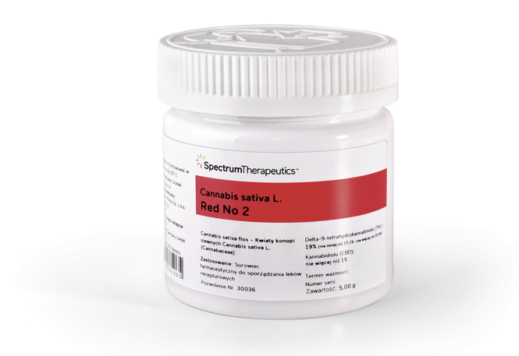
CANNABIS – Q1 FY2026
Cannabis revenue was $57 MM in Q1 FY2026, representing an increase of 24% versus Q1 FY2025
Canada adult-use net revenue was $27MM in Q1 FY2026, representing an increase of 43% compared to Q1 FY2025 driven primarily by strong consumer demand for flower and manufactured cannabis products including infused pre-rolled joint ("PRJ") offerings.
Canada medical cannabis net revenue in Q1 FY2026 increased 13% compared to Q1 FY2025 driven by an increase in the number of insured customers, increased order sizes from our insured customers, and a larger assortment of cannabis products available on the Spectrum online store.
International markets cannabis net revenue was $9MM in Q1 FY2026, representing an increase of 4% over Q1 FY2025, primarily attributable to the increased shipments of flower products into Europe, which was offset by a decline in our Australian medical business.
Cannabis gross margins decreased to 24% in Q1 FY2026 compared to 33% in Q1 FY2025. This decrease was primarily attributable a shift in the product mix in Canada towards higher cost products demanded by Canada Adult-use consumers and lower sales in Poland which historically has high margins.

Slide 13
STORZ & Bickel® – Q1 FY2026
Storz & Bickel delivered net revenue in Q1 FY2026 of $15MM, representing a 25% decrease compared to Q1 FY2025, primarily attributable to lapping strong sales in the prior year and consumer economic uncertainty.
Storz & Bickel gross margin decreased to 29% in Q1 FY2026 compared to 39% in Q1 FY2025 primarily attributable to lower sales and shifts in geographic mix.
Storz & Bickel is preparing to launch a new vaporizer device in the second half of calendar year 2025. The company believes the new line of devices will generate strong consumer interest.

Slide 14
Financial Discipline – reducing Expenses
Expense reduction initiative launched earlier this year has $17MM in annualized savings against original $20MM target
Savings reflect permanent structural changes across multiple functions and markets, including:
    A 15% year-over-year reduction in SG&A headcount
    Elimination of management layers
    Reduced professional fees
    Streamlined back-office functions and non-essential programs
    Company continues to look for additional efficiencies across the organization

Slide 15
Financial Discipline – improving Gross Margins
Canopy Growth has a number of actions underway that are expected to improve cannabis gross margin in the second half of FY2026, including:
  • Implementing new automation and pre-roll capacity to improve production efficiency, both of which are expected to be commissioned before the end of Q3 FY2026.
  Continuing to pursue margin-accretive bulk cannabis sales in Canada and Europe.
  Advancing new European product registrations which are expected to support expanded supply into priority markets in the second half of FY2026.
Canopy Growth has a number of initiatives underway to improve Storz & Bickel gross margins
  Storz & Bickel has implemented several cost efficiency measures, including bringing additional manufacturing capabilities in-house
  Storz & Bickel is preparing to launch a new line of vaporizers in the second half of calendar year 2025.

Slide 16
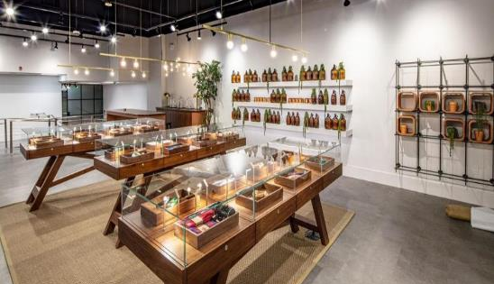

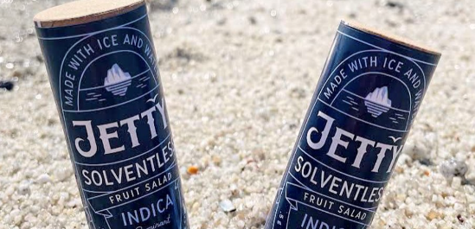
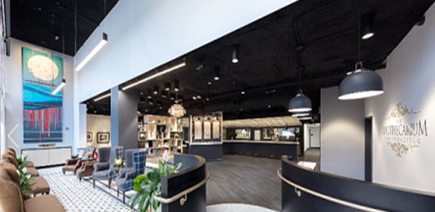




Canopy USA¹ UPDATE
Canopy USA¹ Operating Businesses
Canopy USA¹ Investment
WANA² - gummies
Jetty³ - extracts
ACREAGE⁴ - MSO
TERRASCEND⁵ - MSO
An innovative North American cannabis edibles brand
Authentic vape experience and award-winning technology
Vertical integration from
cultivation to retail
Vertical integration in in PA, NJ,
MI & CA, licensed operations in MD
Canopy USA now fully operational under the leadership of President, Brooks Jorgensen.
Canopy USA is focused on streamlining operations and leveraging its people, products, and footprint to drive growth and scale.
Canopy USA has secured an additional US$22 million in funding for Acreage.
Canopy Growth holds Non-Voting Shares of Canopy USA and until such time as Canopy Growth converts the Non-Voting Shares into Canopy USA Class B Shares following the Stock Exchange Permissibility Date, Canopy Growth will have no economic or voting interest in Canopy USA, Acreage, Wana, Jetty or TerrAscend and these entities will continue to operate independently of Canopy Growth. See risk factors described in the Disclaimers and Cautionary Statements section of this Presentation.
The close of Canopy USA’s acquisition of 100% of Wana , inclusive of Wana Wellness, LLC, The CIMA Group, LLC, and Mountain High Products, LLC was announced on October 9, 2024.
The close of Canopy USA’s acquisition of approximately 77% of Jetty was announced on June 4, 2024.
The close of Canopy USA’s acquisition of 100% of Acreage was announced on December 9, 2024.
The Canopy USA LPs hold an aggregate of 64,564,487 TerrAscend Common Shares on an as-converted basis and 22,474,130 TerrAscend Common Share purchase warrants (the “TerrAscend Warrants”). Assuming full exercise of the TerrAscend Warrants, the Canopy USA LPs will hold an aggregate of 87,038,617 TerrAscend Common Shares on an as-converted basis assuming conversion of the TerrAscend exchangeable shares held by the Canopy USA LPs as of December 31, 2024.
Note 13 of the Notes to Consolidated Financial Statements contained in the Form 10-K filed with the SEC provides summarized balance sheet information, at December 31, 2024, and income statement information, for the eight months ended December 31, 2024, for the Canopy USA equity method investments. The summarized financial statement information presents the consolidated performance of Canopy USA, including Wana, Jetty, and Acreage from their respective date of acquisition close until December 31, 2024.

Slide 17
Q1 FY2026 FINANCIAL RESULTS

Slide 18
Q1 FY2026 KEY FINANCIAL HIGHLIGHTS
Canopy delivered Consolidated Net Revenue of $72 MM in Q1 FY2026, which is up 9 % compared to Q1 of last year,
Main drivers of revenue were:
Cannabis net revenue increased 24% compared to a year ago driven by growth in Canada adult-use, Canada medical and International Markets cannabis revenue.
Storz & Bickel revenue declined 25% attributable to lapping strong sales in the prior year and lower sales caused by consumer economic uncertainty.
Consolidated Gross Margins in Q1 FY2026 was 25%, representing a decline of 1000 bps compared to last year. This decrease was primarily driven by a shift in product mix in Canada due to increased consumer demand for manufactured adult-use cannabis products, lower cannabis sales in the high-margin Poland market and lower Storz & Bickel sales. .
Q1 FY2026 Adjusted EBITDA was a loss of $8MM compared to a loss of $5MM in Q1 FY2025..
Q1 FY2026 Free cash flow, which was an outflow of $12MM, representing a decrease of 79% in outflow compared to Q1 FY2025, primarily driven by lower SG&A expenses, lower working capital use, and the timing of interest payments.
(CDN in millions) | Q1 FY2026 | vs. Q1 FY2025
Net Revenue | $72.1 | (9%)
Gross Margin | 25.0% | (1000bps)
Adjusted EBITDA¹ | $(7.9) | (50%)
Free Cash Flow¹ | $(11.6) | 79%
Cash / Marketable Secs. | $144 | (26%)
¹ Adjusted EBITDA and Free Cash Flow are Non-GAAP Measures. See Non-GAAP Measures section in the Disclaimers and Cautionary Statements section of this Presentation.

Slide 19
REVENUE PERFORMANCE BY CHANNEL¹
(in millions of Canadian dollars, unaudited) | Q1 FY2026 | Q1 FY2025 | vs. Q1 FY2026
Cannabis
Canada adult-use cannabis² | $27.0 | $18.9 | 43%
Canada medical cannabis³ | $21.2 | $18.8 | 13%
International markets cannabis | $8.8 | $8.4 | 5%
 | $57.0 | $46.1 | 24%
Storz & Bickel | $15.1 | 20.1 | (25%)
Net Revenue | $72.1 | $66.2 | 9%
1 In Q1 FY2026, we are reporting our financial results for the following two reportable segments: (i) Cannabis; and (ii) Storz & Bickel. 2 For Q1 FY2026, amount is net of excise taxes of $14.2MM and other revenue adjustments of $0.9MM (Q1 FY2025 - $7.5MM and $1.2MM, respectively). 3 For Q1 FY2026, amount is net of excise taxes of $2.4MM (Q1 FY2025 - $2.1MM).

Slide 20
GROSS MARGIN PERFORMANCE
Gross Margin Year-over-Year Change By Reportable Segment
Consolidated
Gross Margin
Drivers of Q1 FY2026
Consolidated Gross Margin Performance
(-) The decline in gross margins in cannabis segment due primarily to i) Shift in product mix in Canada due to increased consumer demand for manufactured adult-use cannabis products and ii) Lower cannabis sales in the high-margin Poland market
(-) The decline in the Storz & Bickel segment due primarily to lower sales
Q1
FY25
Q1
FY26
Cannabis
Gross Margin
Storz & Bickel
Gross Margin
Q1
FY25
Q1
FY26
Q1
FY25
Q1
FY26

Slide 21
FREE CASH FLOW AND DEBT
Reduced overall debt to $295MM in Q1 FY2026

Slide 22
APPENDIX

Slide 23
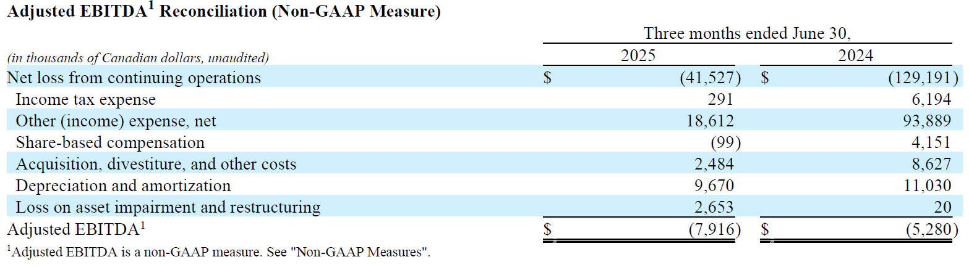
ADJUSTED EBITDA¹
(NON-GAAP) RECONCILIATION

Slide 24
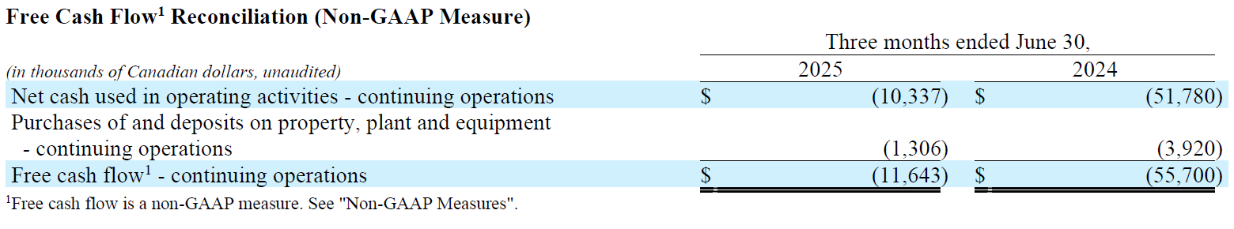
FREE CASH FLOW¹
(NON-GAAP) RECONCILIATION

Slide 25
THANK YOU

